Slide 1
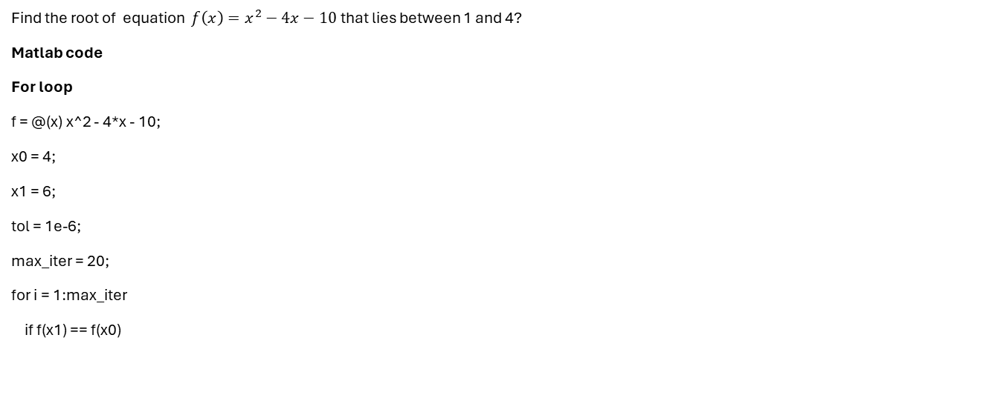
SECANT METHOD
Find the root of equation $f\left(x\right)=x^{2}−4x−10$ that lies between 1 and 4?
Matlab code
For loop
f = @(x) x^2 - 4*x - 10;
x0 = 4;
x1 = 6;
tol = 1e-6;
max_iter = 20;
for i = 1:max_iter
if f(x1) == f(x0)

Slide 2
disp('Error: Division by zero');
break;
end
x_next = x1 - (f(x1) * (x1 - x0)) / (f(x1) - f(x0));
fprintf('Iteration %d: x = %.6f\n', i, x_next);
if abs(f(x_next)) < tol
fprintf('\nRoot found: x = %.6f\n', x_next);
break;
end
x0 = x1;
x1 = x_next;
end

Slide 3
using while loop
f = @(x) x^2 - 4*x - 10;
x0 = 4;
x1 = 6;
tol = 1e-6;
iter = 0;
max_iter = 20;
err = abs(f(x1));
while err > tol && iter < max_iter
iter = iter + 1;
x_next = x1 - (f(x1) * (x1 - x0)) / (f(x1) - f(x0));
err = abs(f(x_next));
fprintf('Iteration %d: x = %.6f\n', iter, x_next);
x0 = x1;
x1 = x_next;
end
fprintf('\nRoot found: x = %.6f\n', x_next);

Slide 4
Pseudocode
BEGIN
x0 ← 1
x1 ← 4
Tol ← 0.0001
REPEAT
f0 ← x0^2 - 4*x0 - 10
f1 ← x1^2 - 4*x1 - 10
x2 ← x1 - (f1 * (x1 - x0)) / (f1 - f0)
Error ← ABS(x2 - x1)
IF Error < Tol THEN
PRINT "Root =", x2
EXIT LOOP
ENDIF
x0 = x1
x1 = x2
UNTIL FALSE
END

Slide 5
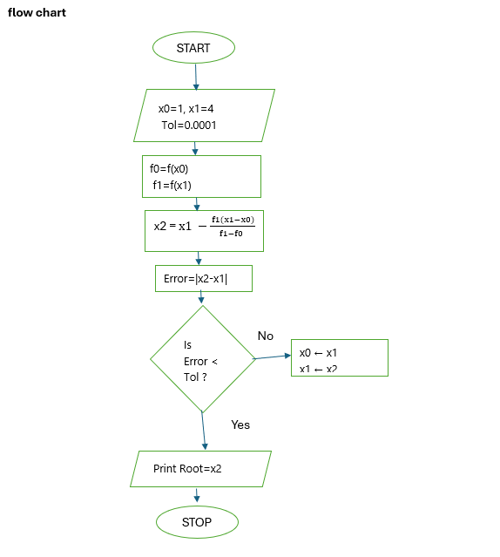

Slide 6
NEWTON RAHPSON METHOD
Use Newton-Raphson method to solve the equation x3-7x2+5x-4=0 near x0 =5 correct to 8 decimal places.
Matlab code
For loop
f = @(x) x^3 - 7*x^2 + 5*x - 4;
df = @(x) 3*x^2 - 14*x + 5;
x0 = 5;
tol = 1e-8;
max_iter = 20;
for i = 1:max_iter
if df(x0) == 0
disp('Error: Derivative is zero.');
break;
end
x_next = x0 - f(x0) / df(x0);
fprintf('Iteration %d: x = %.8f\n', i, x_next);
if abs(x_next - x0) < tol
fprintf('\n[FOR LOOP] Root found: x = %.8f after %d iterations.\n', x_next, i);
break;
end
x0 = x_next;
end

Slide 7
while loop
f = @(x) x^3 - 7*x^2 + 5*x - 4;
df = @(x) 3*x^2 - 14*x + 5;
x0 = 5;
tol = 1e-8;
max_iter = 20;
iter = 0;
diff = tol + 1; % Initialize diff greater than tol to enter loop
while diff >= tol && iter < max_iter
iter = iter + 1;
if df(x0) == 0
disp('Error: Derivative is zero.');
break;
end
x_next = x0 - f(x0) / df(x0);
diff = abs(x_next - x0);
fprintf('Iteration %d: x = %.8f\n', iter, x_next);
x0 = x_next;
end
if diff < tol
fprintf('\n[WHILE LOOP] Root found: x = %.8f after %d iterations.\n', x_next, iter);
else
fprintf('\nDid not converge within %d iterations.\n', max_iter);
end

Slide 8
pseudocode
START
x ← 5
Tol ← 0.00000001
REPEAT
f ← x^3 - 7*x^2 + 5*x - 4
df ← 3*x^2 - 14*x + 5
x_new ← x - (f/df)
Error ← |x_new - x|
x ← x_new
UNTIL Error < Tol
PRINT "Root =", x
STOP

Slide 9
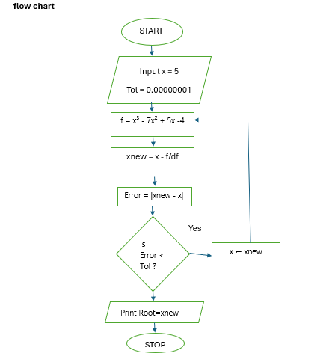

Slide 10
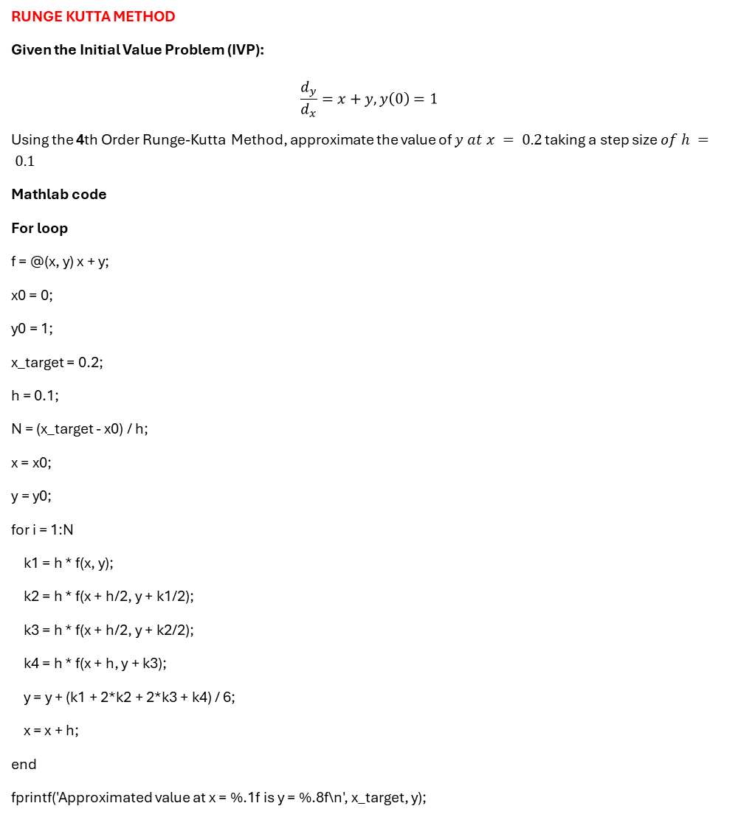
RUNGE KUTTA METHOD
Given the Initial Value Problem (IVP):
$$\frac{d_{y}}{d_{x}}=x+y, y\left(0\right)=1$$
Using the 4th Order Runge-Kutta Method, approximate the value of $y at x = 0.2$ taking a step size $of h = 0.1$
Mathlab code
For loop
f = @(x, y) x + y;
x0 = 0;
y0 = 1;
x_target = 0.2;
h = 0.1;
N = (x_target - x0) / h;
x = x0;
y = y0;
for i = 1:N
k1 = h * f(x, y);
k2 = h * f(x + h/2, y + k1/2);
k3 = h * f(x + h/2, y + k2/2);
k4 = h * f(x + h, y + k3);
y = y + (k1 + 2*k2 + 2*k3 + k4) / 6;
x = x + h;
end
fprintf('Approximated value at x = %.1f is y = %.8f\n', x_target, y);

Slide 11
While loop
f = @(x, y) x + y;
x = 0;
y = 1;
x_target = 0.2;
h = 0.1;
tol = 1e-12;
while x < (x_target - tol)
k1 = h * f(x, y);
k2 = h * f(x + h/2, y + k1/2);
k3 = h * f(x + h/2, y + k2/2);
k4 = h * f(x + h, y + k3);
y = y + (k1 + 2*k2 + 2*k3 + k4) / 6;
x = x + h;
end
fprintf('Approximated value at x = %.1f is y = %.8f\n', x_target, y);

Slide 12
pseudocode
START
Input x, y, h, xn
WHILE x < xn DO
k1 ← h * f(x, y)
k2 ← h * f(x + h/2, y + k1/2)
k3 ← h * f(x + h/2, y + k2/2)
k4 ← h * f(x + h, y + k3)
y ← y + (k1 + 2*k2 + 2*k3 + k4)/6
x ← x + h
END WHILE
Print y
STOP

Slide 13


